Slide 1
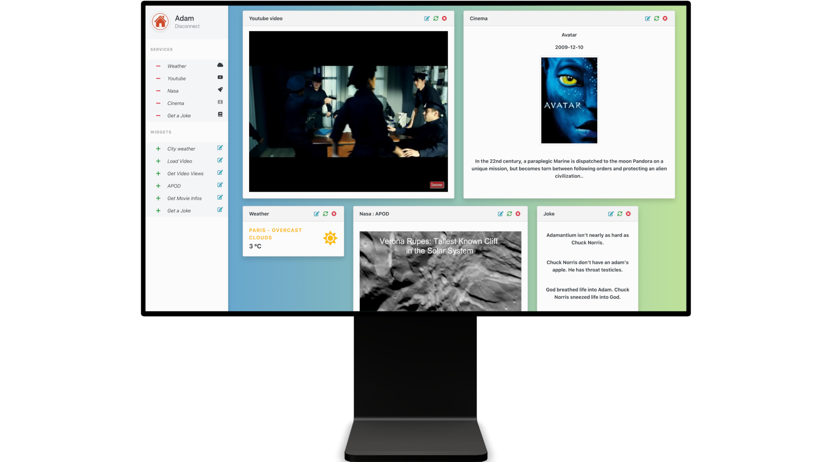
DOC UI/UX : DASHBOARD

Slide 2
STEP 1: WELCOME
The user can select between sign up or login.

Slide 3
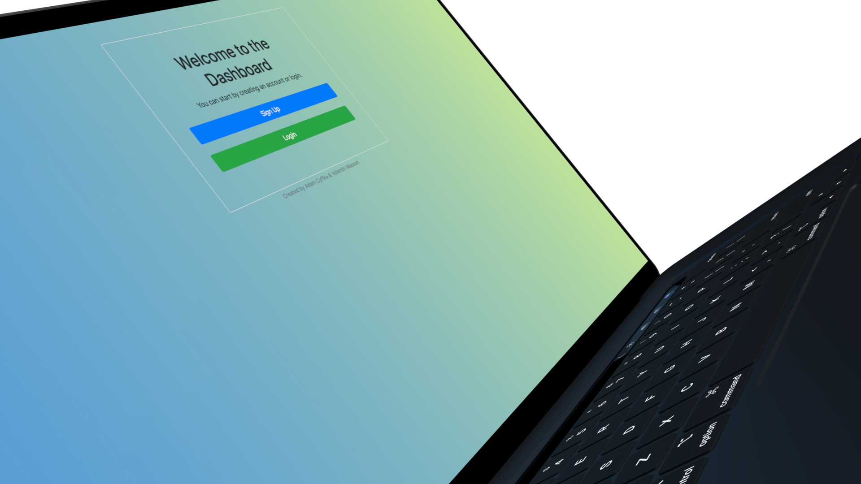

Slide 4
STEP 2: AUTHENTICATION
The user has the possibility to create an account or to log in. It can also login / register with Facebook, Google, Spotify or Discord.

Slide 5
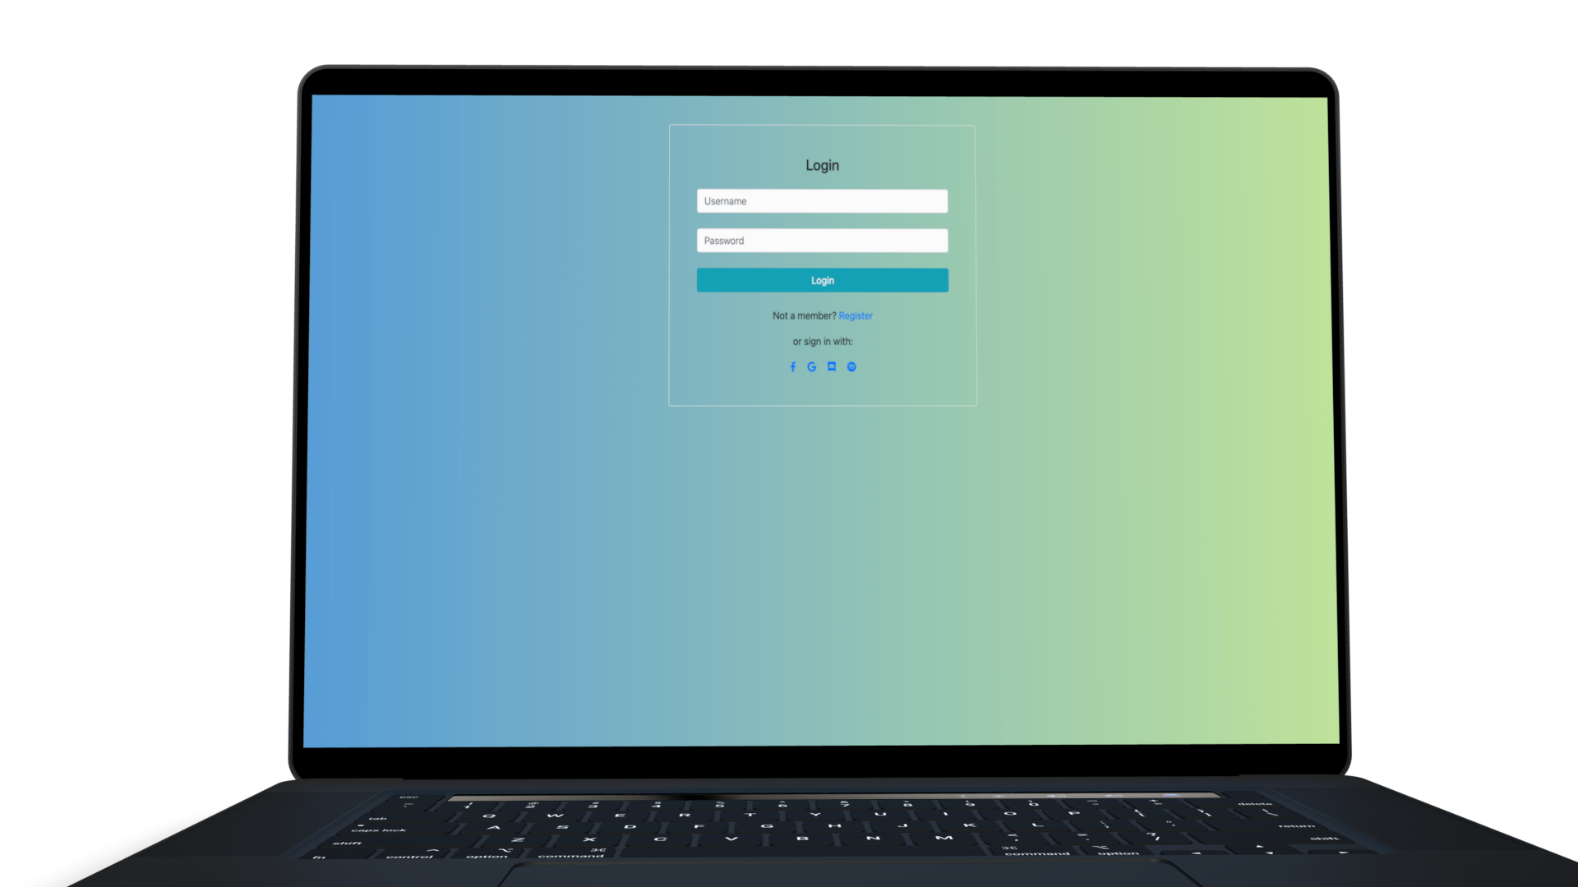

Slide 6

STEP 3: SECURITY
For security reasons, the user cannot create an account with the same email.

Slide 7
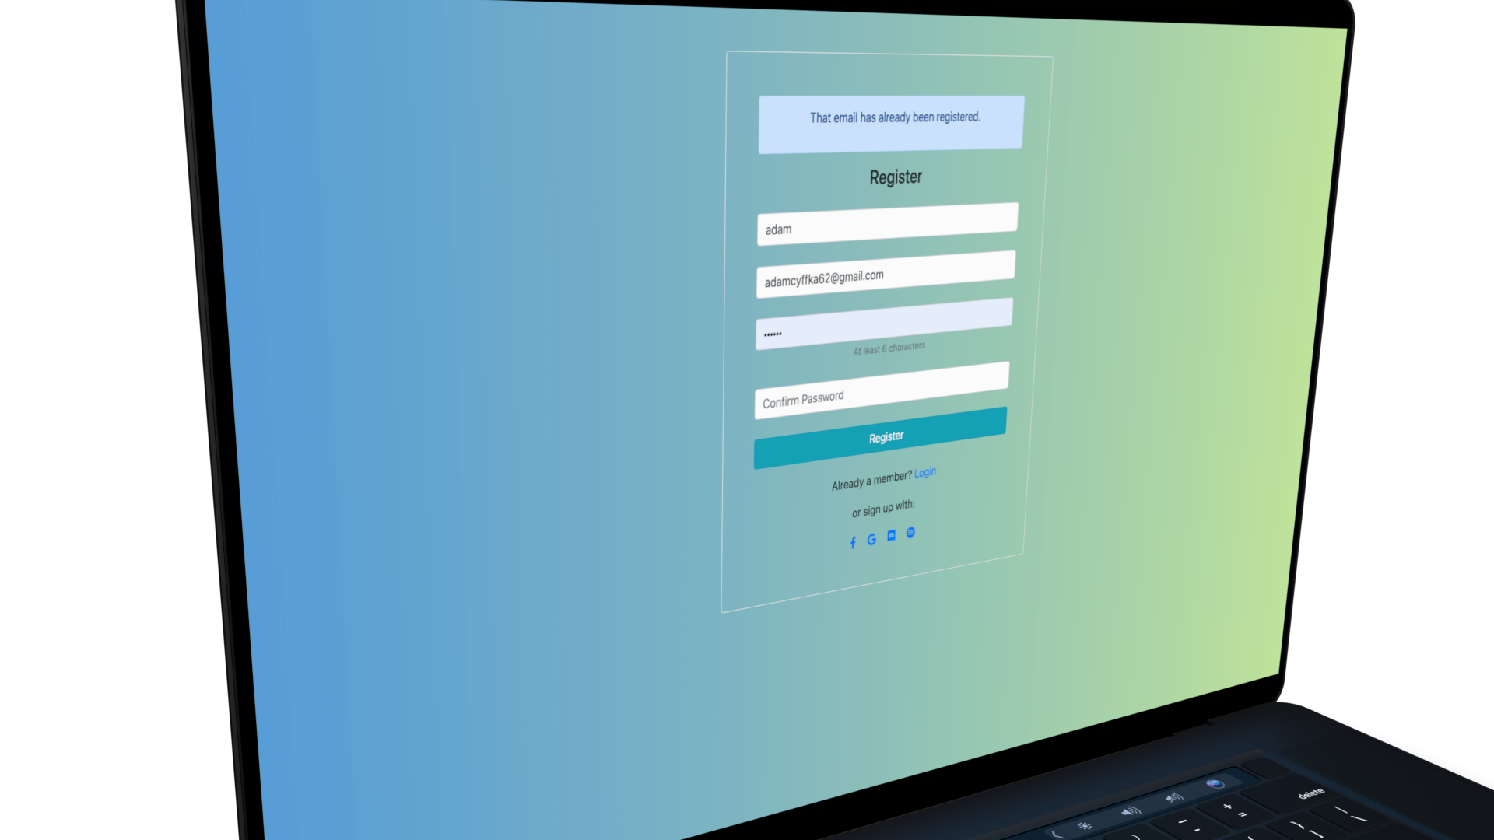

Slide 8
STEP 4: DASHBOARD
Once the user is logged in, they can start using the Dashboard.

Slide 9
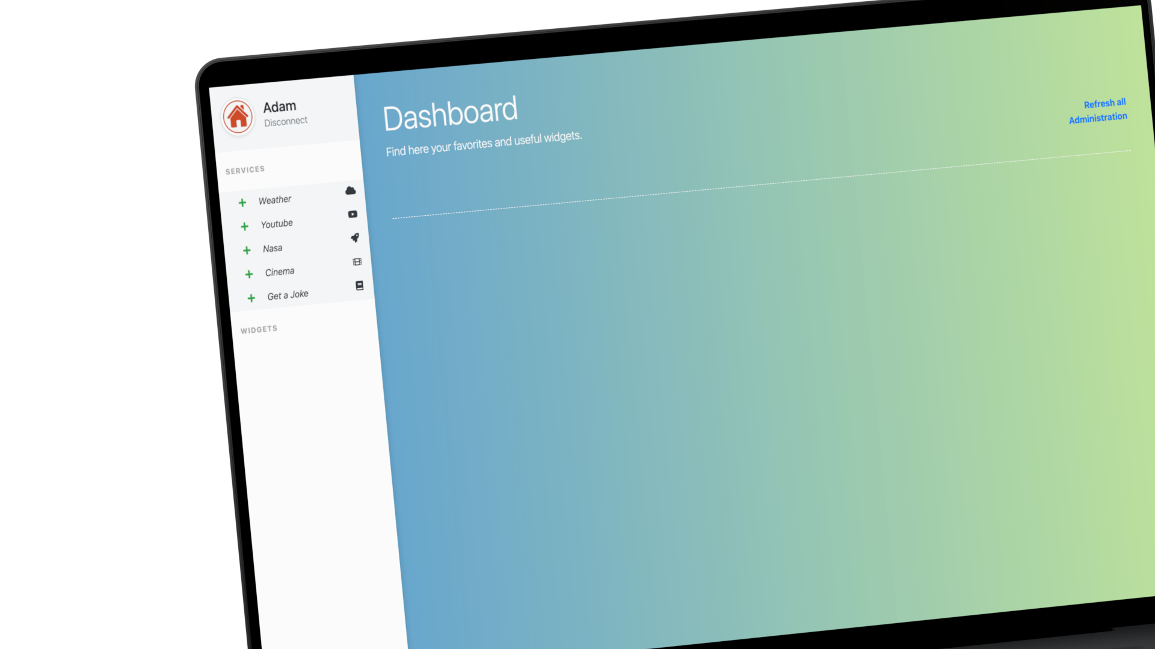

Slide 10
STEP 5: SERVICES
To add services and see their widgets, click on the "+" button in the list of services on the left of the screen

Slide 11
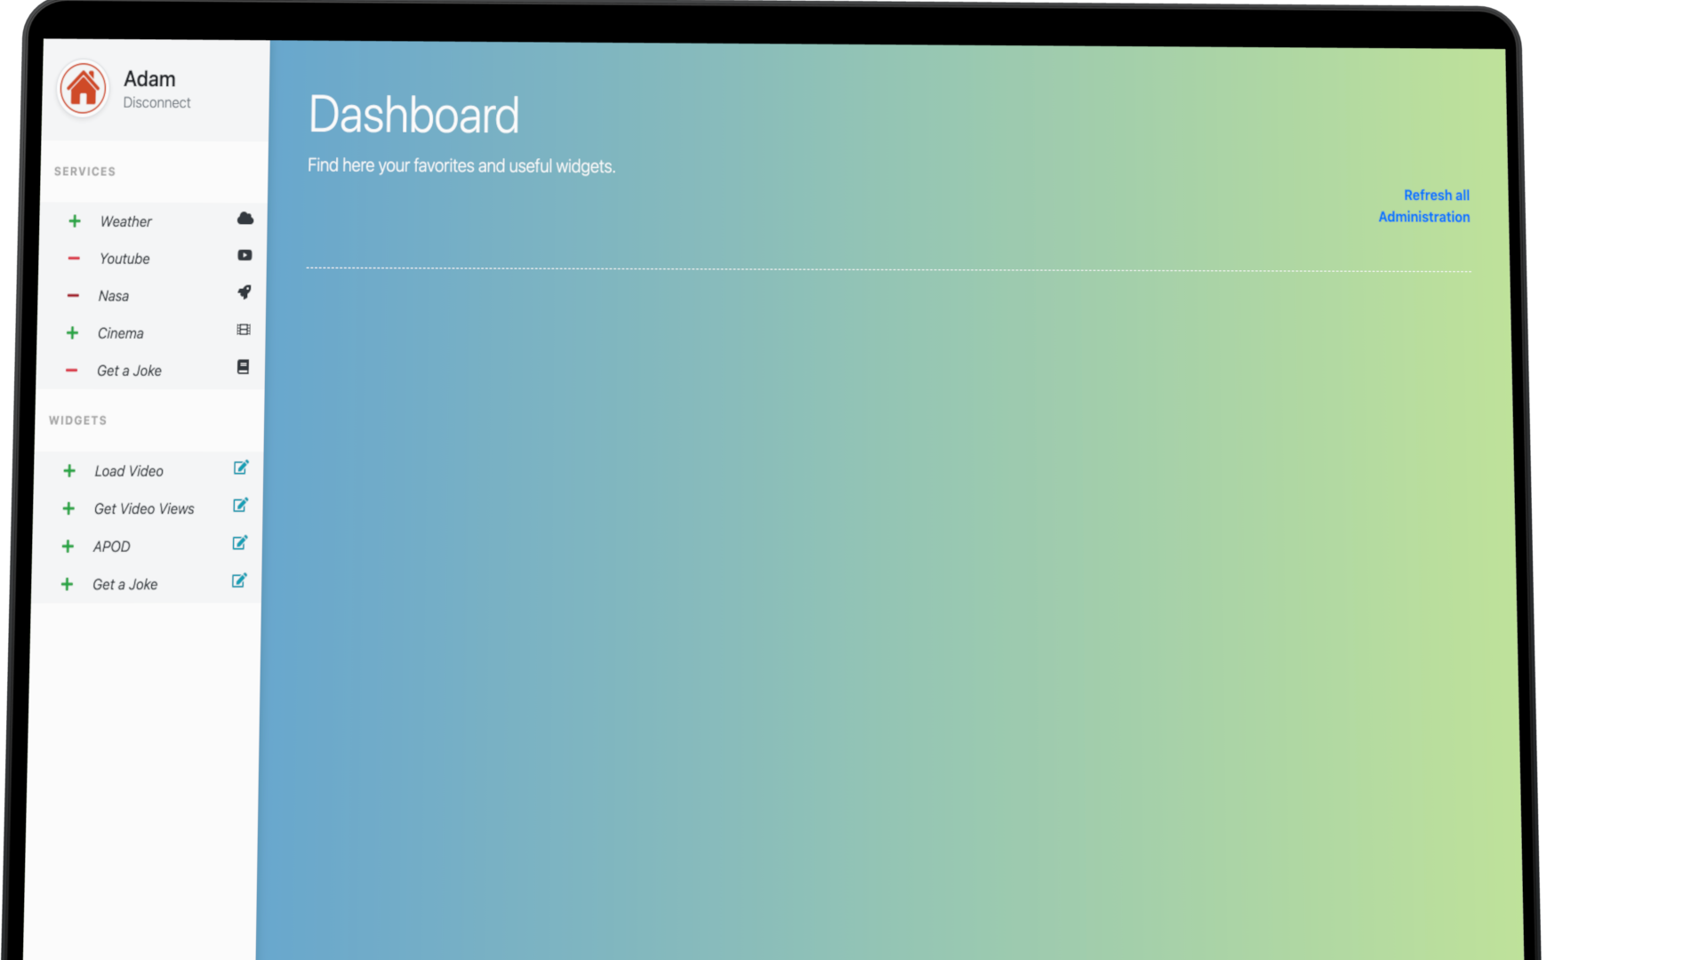

Slide 12

STEP 6: WIDGETS
To add widgets, click on the "+" button in the list of widgets on the left of the screen. You can edit the value of each widget by clicking on the edit button in the right of each widget.

Slide 13
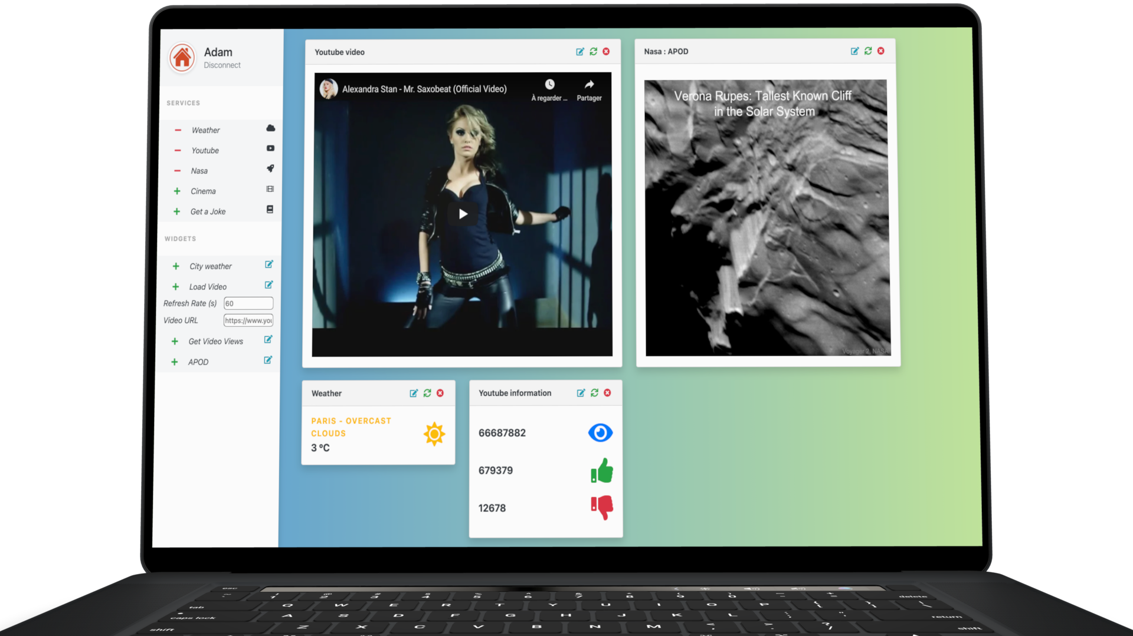

Slide 14
STEP 7: WIDGETS OPTIONS
For each widget on the Dashboard, you can delete it, edit value or refresh.

Slide 15
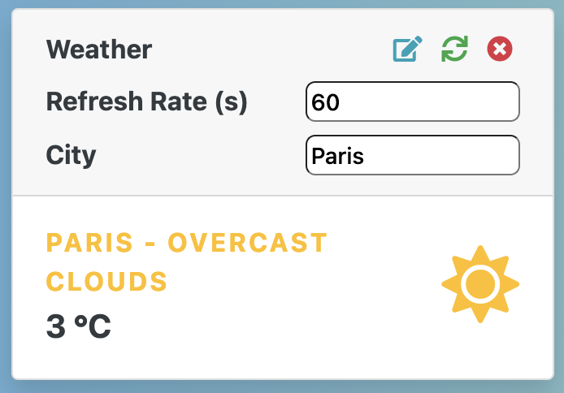

Slide 16

STEP 8: ADMINISTRATION
If you click on “Administration” in the left side of the Dashboard, you’ll see the admin page. In this page, you can see all registered users. You can add or edit their role (superadmin, admin or user). By default, the first registered user is superadmin.

Slide 17
